Slide 1
Bitcoin – anonymity [Zerocoin + Zerocash]

Slide 2
Zerocoin
earlier solutions – anonymity as a layer
online wallets
mixes
Coinjoin
high-level flows
mixing by design
anonymity as a protocol component
cryptographic guarantees
not currently compatible with Bitcoin
tradeoffs
1
Notes:
-mechanisms looked at so far: online wallets, mixes, decentralized mixes, Coinjoin, high level flows
-crypto proofs – qualitatively different
-anonymity depends on adversary’s computational power

Slide 3

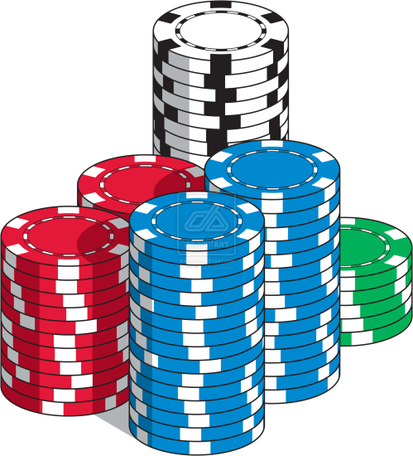
Zerocoin paradigm
Basecoin – a normal altcoin
Zerocoin – an extension of Basecoin
inter-conversion
process breaks linkages
Zerocoin: a crypto proof that you own a Basecoin which is now unspendable
miners can verify these proofs
use proof to acquire a new Basecoin
poker chips!
2
Notes:
-basecoins and zerocoins can be converted from one to the other
-’minting’ process
-this process breaks the links between them
-analogy of poker chips
-you do not spend poker chips directly!

Slide 4
challenges
how to construct these proofs?
how to make sure proofs are not redeemed more than once?
3
Notes:
-person might convert basecoin into zerocoin and then redeem it several times?

Slide 5

Zero knowledge proofs
Prove a statement without revealing any other information
e.g. “I know an input that hashes to da39a3ee5e”
without revealing x!
also - “I know an input that hashes to some hash in the following set: … ”
magic!
black box
4

Slide 6

Minting zerocoins
Zerocoins come in standard denominations
let’s assume 1 Basecoin
anyone can make one!
they have value once put on the blockchain
a ‘commitment’
Alice generates a serial number, S
and a random secret, r
compute H(S,r)
Serial number:
317038628684424
5
Notes:
-the serial number S is eventually made public
-random secret, r, is never made public – and ensures unlinkability

Slide 7
Minting zerocoins
Mint transaction: puts H(S,r) on blockchain
requires 1 basecoin as input
output ‘address’ is the commitment
r, S not revealed!
signed by A
Mint
H(S, r) H( )
6

Slide 8
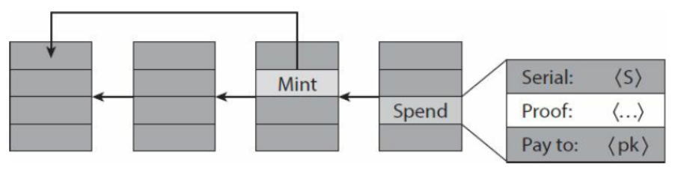
Spending zerocoin
reveal S - miners will verify S hasn’t been spent before
Create zero-knowledge proof that: “I know a number r such that H(S, r) is one of the zerocoins in the block chain”
pick arbitrary zerocoin in blockchain & use as input to your new transaction
7
Notes:
-serial number is revealed!
-spending transaction requires no signature
-miners will verify your ZKP which establishes your ability to open one of the zerocoin commitments on the blockchain without actually opening it
-miners will also check serial number S has not been used before (ergo no double spend)
-output acts as a new basecoin! Use an address that you own!
-serial number now becomes public and can never be redeemed again

Slide 9

coinjoin
since r is secret, no one can figure out which zerocoin corresponds to serial number S
H(S, r)
…
h₁
h₂
h_{N}
proof is a giant disjunction over all zerocoins
I know r such that
H(S, r) = h1 OR H(S, r) = h2 OR … OR H(S, r) = hN
yet the proof is relatively small!
8
Notes:
-r is kept secret throughout!
-therefore nobody knows which serial number corresponds to *which* zerocoin
-crypto magic!
-no envelope analog!
-very efficient!
-you would expect ZKPs to grow linearly as n increases (i.e. as more zerocoins are mined), but Zerocoin makes proofs logarithmic in n – and statement does not need to be included with the proof, it is implicit.
-however, some sizable overhead compared to Bitcoin – proofs are around 50 kB in size

Slide 10
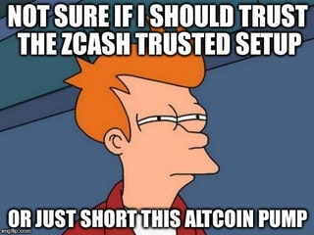
disadvantage
one-time trusted setup required
RSA accumulators
choose two large primes, p and q
publish N = p.q
destroy p and q
convince everyone of it
else create infinite new zerocoins
threshold crypto
9

Slide 11

zerocash
zero-knowledge succinct non-interactive arguments of knowledge (zk-SNARKs)
very efficient and compact ZKPs
no more basecoins!
transaction amounts and addresses are inside commitments and not visible on blockchain!
ledger records existence
crypto proofs ensure that everything works properly
10
Notes:
-Zerocoin has two different modes – regular transactions without anonymity and computationally expensive mixing transactions
-Zerocash – all is one
-in a league of its own!
-immune to mixing side-channel attacks – because transaction amounts do not show up on blockchain
-again serious trusted setup issues here
-much more than Zerocoin
-Zerocoin requires N, i.e. a few hundred bytes of data
-Zerocash requires 1Gb of public parameters!
-if anyone knows these inputs, security properties are compromised – enables undetectable double spends

Slide 12
conclusion
System | Type | Anonymity attacks | Deployability
Bitcoin | Pseudonymous | Tx graph analysis | Default
Single mix | Mix | Tx graph analysis, bad mix | Usable today
Mix chain | Mix | Side channels, bad mixes/peers | Bitcoin-compatible
Zerocoin | Cryptographic mix | Side channels (possibly) | Altcoin
Zerocash | Untraceable | None | Altcoin, tricky setup
11
Notes:
-also defeats clustering

Slide 13
Homework
Chap 6: Bitcoin and Anonymity Bitcoin and Cryptocurrency Technologies: A Comprehensive Introduction
How to explain zero knowledge proofs to your children (link)
Zcoin vs. Zcash – very interesting! (link)
12

Slide 14
Further reading
A big mixnet closes (link)
13

